Slide 1

B.N.M Institute of Technology
Internship-2
Project Demonstration
Project: Solving the CartPole Problem with Deep Q-Networks (DQN)
Aneesh M S – 1BG23CS014
Divyasree – 1BG23CS036
Kshithija K M – 1BG23CS064

Slide 2

Deep Q-Learning for Control Environments
Welcome to our presentation on Deep Q-Learning. We explore its application in control environments. Our project focuses on training intelligent agents. We aim to achieve stable and high-performance control. This presentation will cover our objectives, workflow, results, and future plans. We will also discuss the challenges and key learnings.

Slide 3
Project Objective
Train DQN Agents
OpenAI Gym Environments
Achieve Stable Control
Surpass Baseline
To train and evaluate Deep Q-Network (DQN) agents. This involves developing neural networks. They learn optimal actions from experience.
Significantly surpass baseline random agent performance. This validates the effectiveness of DQN. It shows learned intelligence.
Focus on OpenAI Gym's CartPole-v1 and MountainCar-v0. These are simulated physics environments. They offer distinct control challenges.
The primary goal is stable control and high performance. Agents must consistently succeed in tasks. Performance metrics will guide training.

Slide 4






Technical Workflow
Reinforcement Learning Framework
OpenAI Gym for environment interaction. It provides standardised interfaces. This eases agent training. It's a robust simulation platform.
Deep Learning Library
PyTorch 1.13.1 for neural network implementation. This powerful library facilitates deep learning. It supports dynamic computation graphs.
Q-Network Architecture
Two hidden layers (128, 64 neurons). ReLU activation ensures non-linearity. This architecture balances complexity and performance.
Experience Replay Buffer
Capacity of 100,000 transitions. It decorrelates samples during training. This improves learning stability and efficiency.
Exploration Strategy
Epsilon-greedy, decaying from 1.0 to 0.01. This occurs over 10,000 episodes. It balances exploration with exploitation.
Optimization
Adam optimizer with a learning rate of 0.0005. This optimises neural network weights. It helps in converging to optimal policies.

Slide 5
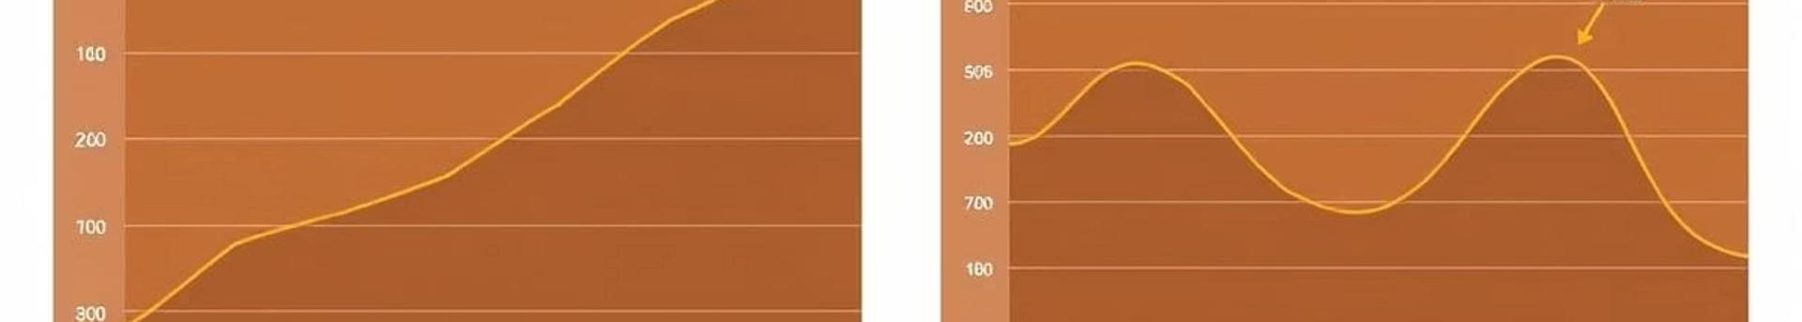
Performance Results
200
20-25
-110
-200
CartPole-v1 Score
CartPole Baseline
MountainCar-v0 Score
MountainCar Baseline
DQN agent achieved an average score. This was over 100 consecutive episodes. It indicates stable pole balancing.
Random agent baseline average score. This highlights the significant improvement. Our DQN agent outperforms it.
DQN agent achieved an average score. This was also over 100 consecutive episodes. It shows efficient hill climbing.
Random agent baseline average score. The goal was rarely reached. Our agent dramatically improved.

Slide 6
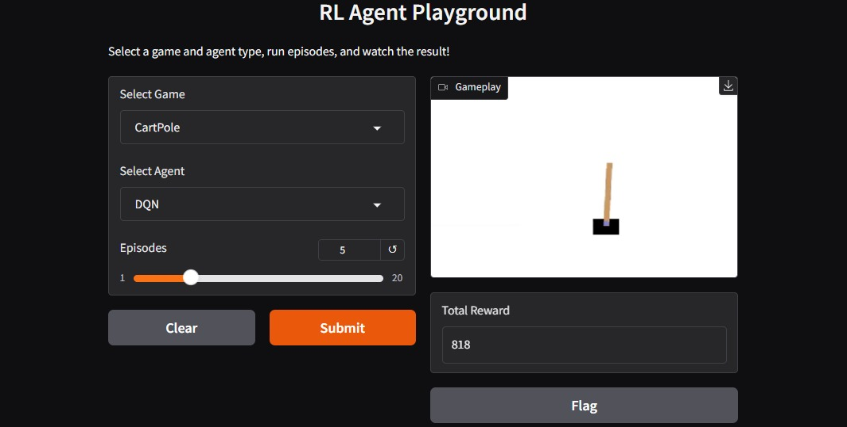
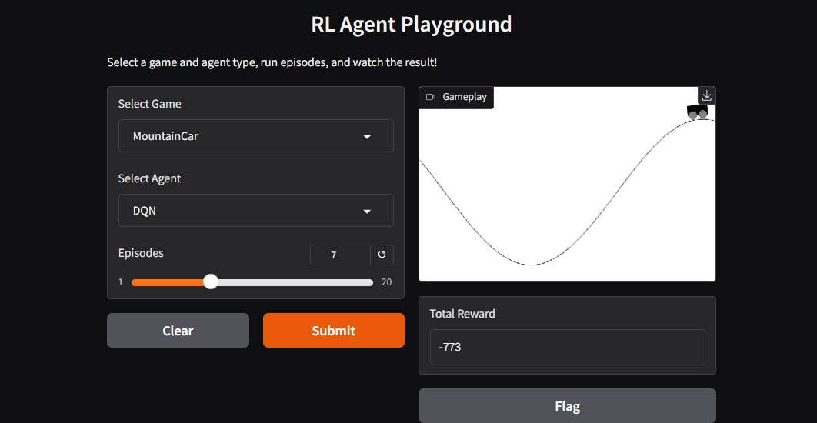
Project Outcomes
Trained DQN Models Serialized PyTorch models (.pt files) for both environments. These are ready for deployment and testing.
Interactive UI Gradio interface for real-time inference and visualisation. It allows users to interact easily.
Video Demonstrations Recorded gameplay of trained agents. These videos interact with environments. They showcase agent capabilities.
Code Repository Well-documented Python codebase on GitHub. It includes Jupyter notebooks and scripts. This ensures reproducibility.

Slide 7

Future Work & Enhancements
Interactive Control
Integrate keyboard input for direct user control in Gradio UI. This enhances user engagement and testing.
Advanced Algorithms
Implement Double DQN to mitigate overestimation bias. This can lead to more stable and optimal policies.
Hyperparameter Tuning
Automated tuning using libraries like Optuna. This achieves optimal performance more efficiently.
Real-world Application
Explore integration with robotic control simulations (e.g., PyBullet). This bridges simulation with practical robotics.

Slide 8

Challenges & Learnings
Hyperparameter sensitivity
Iterative tuning, understanding impact.
Ensuring stability
Target network, replay, gradient clipping.
Balancing exploration-exploitation
Fine-tuned epsilon decay schedule.
Key Learning
DQN's power in discrete control.

Slide 9

Conclusion & Q&A
We successfully implemented and trained DQN agents. These agents performed well in both CartPole and MountainCar environments. We demonstrated effective application of deep reinforcement learning concepts. The project offers promising avenues for future research. It also opens doors for practical deployment. Thank you for your attention. We are now open for any questions and discussions.

